Slide 1
Financial Research System
Daniel Li

Slide 2
Overview
AI system that answers financial questions by searching through SEC filings, earnings transcripts, and news articles
RAG + agentic AI with data fetching, vector search, and multi-step reasoning

Slide 3
Components
ETL orchestration + pipeline for extracting and processing financial data
Retrieval system with searchable indices for processed documents
Agents for providing LLM integration/tool execution

Slide 4
Data Flow
User asks: “What are the risks for Apple?”
Intent parsing: Detects ticker “AAPL”, needs filings
Auto-orchestrator: Checks for filings, fetches if missing
Processing: Extracts sections, generates embeddings
Indexing: Rebuilds vector indices
Agent search: Searches filings for risk-related content
Synthesis: LLM synthesizes findings with citations
Response: Returns answer with source references

Slide 5
Key Features
ReAct reasoning: agents use Thought → Action → Observation loops
  Gathers evidence & iterate after each observation
DocETL: runs during processing to create more structured outputs from filings/transcripts/news
Notes:
react loop reduces hallucinations
in the case with more than one ticker, it runs a separate react loop for each ticker, then aggregates
docetl is better because it produces more insightful documents compared to raw text chunks

Slide 6
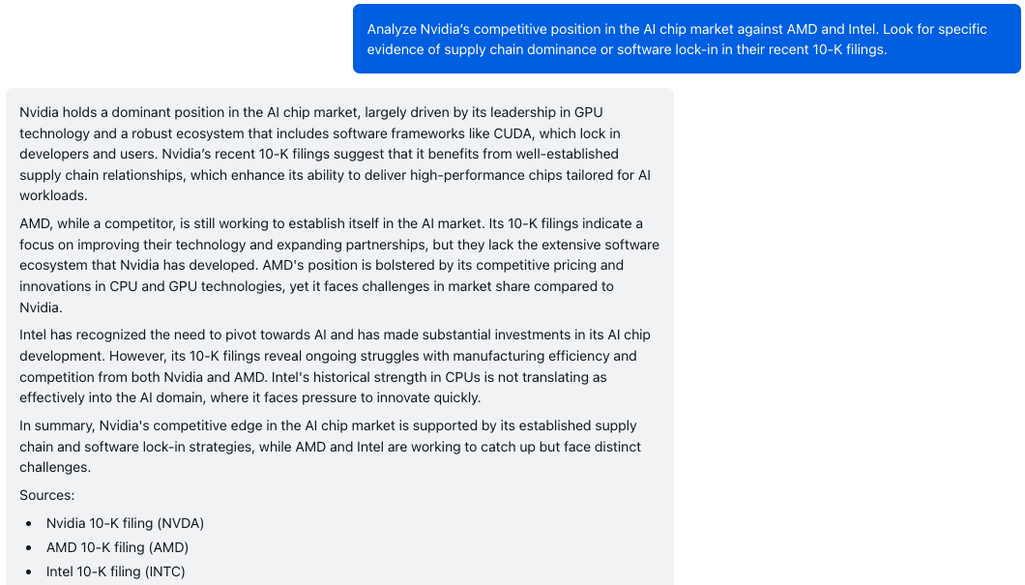
Sample Query #1

Slide 7
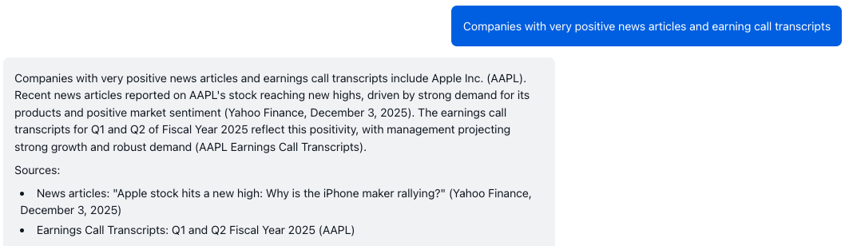
Sample Query #2

Slide 8
Limitations + Possible improvements
Improve vector embeddings with domain-specific knowledge
Combine querying over structured + unstructured data

